Slide 1
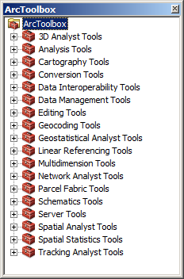
Analysis Tools
Analysis Tools
Vector Analysis
Spatial Analyst
Raster Analysis
Geostatistical Analyst
Interpolation
Spatial Statistics
Patterns
Clusters

Slide 2
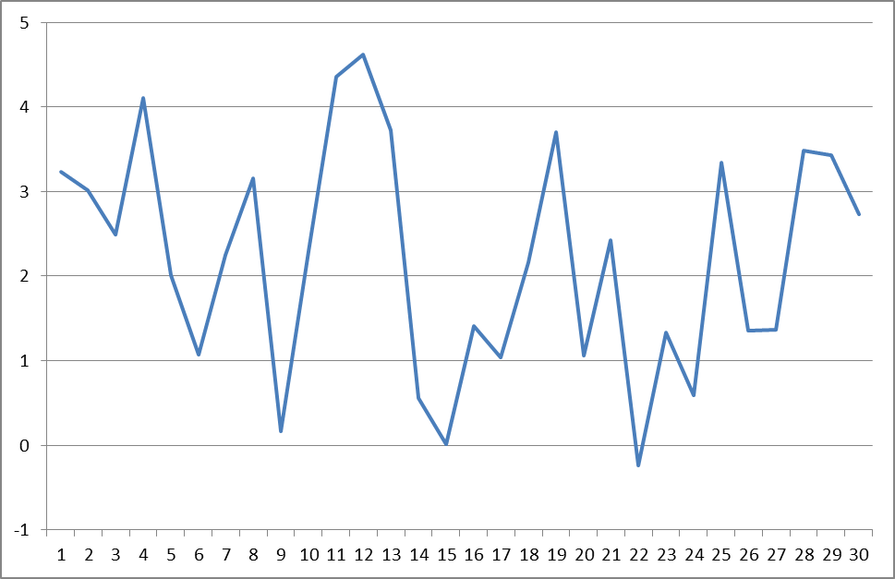
Auto-Correlation
Auto – self
Correlation - related
Does this signal have auto-correlation?
Notes:
Try squinting your eyes!

Slide 3
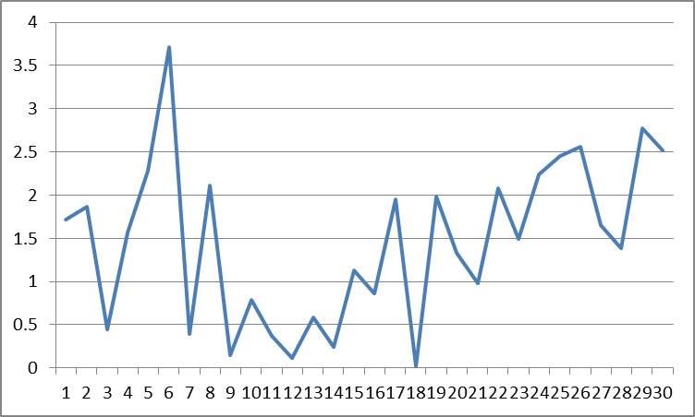
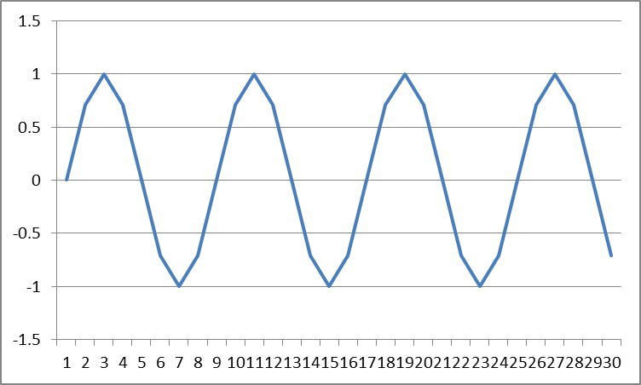
Signal Components
Random Component
Uniform

Slide 4
Is Correlation Bad?
Most statisticians see correlation as bad because it can lead to results that are misinterpreted
Spatial auto-correlation can be bad for the same reason so we must detect it
Without spatial auto-correlation, we should not be doing spatial interpolation

Slide 5
First Law of Geography
"Everything is related to everything else, but near things are more related than distant things.“
Waldo Tobler
(1970) "A computer movie simulating urban growth in the Detroit region". Economic Geography

Slide 6
Measuring Autocorrelation
Moran’s I
Spatial Statistics Tools -> Analyzing Patterns -> Spatial Autocorrelation (Moran’s I)
0 ~ Random
1 = Perfect Correlation
-1 = Perfect Dispersion (pattern)
ArcGIS Help

Slide 7
Moran’s I Results
0.8 = Spatial Autocorrelation
-0.05 = Random
-1 = Opposite of autocorrelation

Slide 8
Moran’s I
If the $z_{i}$and $z_{j}$in the numerator vary in the same way from the mean (positively or negatively), the numerator will be positive.
If $z_{i}$and $z_{j}$ vary in opposite ways from the mean, the numerator will be negative.
Notes:
- Note that I and j are not x and y, they are simply sampling the set of points

Slide 9
Moran’s I Weights

Slide 10
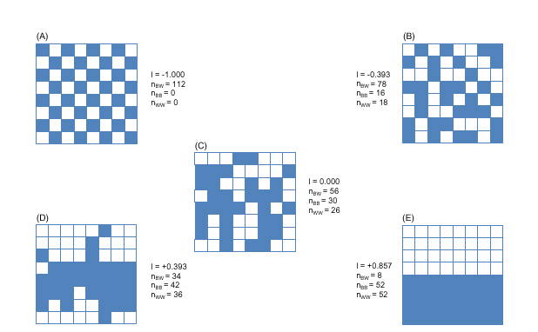
Moran’s I

Slide 11
Spatial Autocorrelation Game
Northern Kentucky University
http://www.nku.edu/~longa/cgi-bin/cgi-tcl-examples/generic/SA/SA.cgi

Slide 12
Other measures
Geary’s C
Inversely related to Moran’s I
More sensitive to local spatial correlation

